Slide 1

PA 604
QUANTITATIVE DATA ANALYSIS
PROFESSOR BURREL VANN JR

Slide 2
QUANTITATIVE DATA
THE NUMERICAL REPRESENTATION OF OBSERVATIONS FOR THE PURPOSE OF DESCRIBING AND EXPLAINING PHENOMENA
Notes:
Quantification – converting your data into numbers, and making them usable for computers.
Univariate: one variable
Bivariate: two variables
Multivariate: more than two variables, with a bunch of independent variables and one dependent variable.

Slide 3

QUANTITATIVE CODES/CODING
Assigning numbers to attributes of variables

Slide 4


AGE
1 = 1
2 = 2
3 = 3
< 18 = 1
18-24 = 2
25-29 = 3
30+ = 4
POLITICAL AFFILIATION
Democrat = 1
Republican = 2
Independent = 3
Other = 4
SEX
Female = 1
Male = 2
Other = 3
SOCIOECONOMIC STATUS
Working = 1
Middle = 2
Upper-Middle = 3
The One Percent = 4

Slide 5
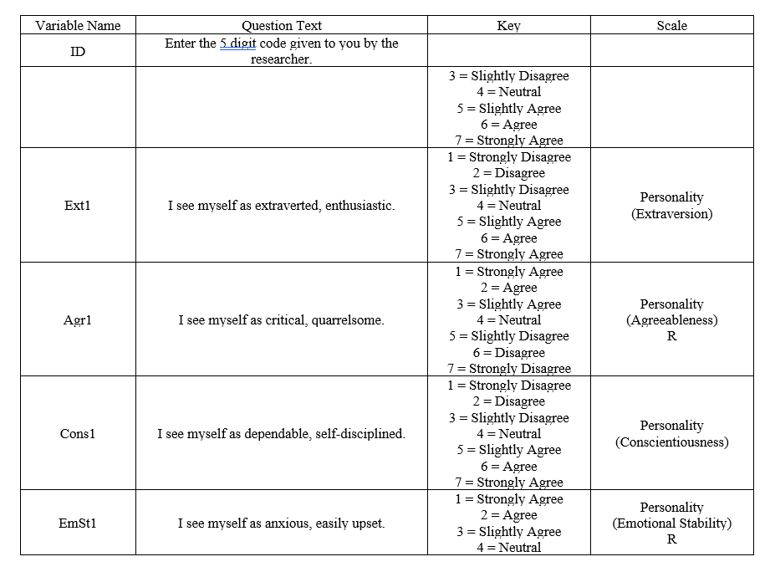
CODEBOOK
A document that lists the assignments of codes to the attributes composing the variables (meanings of codes, and code labels).

Slide 6
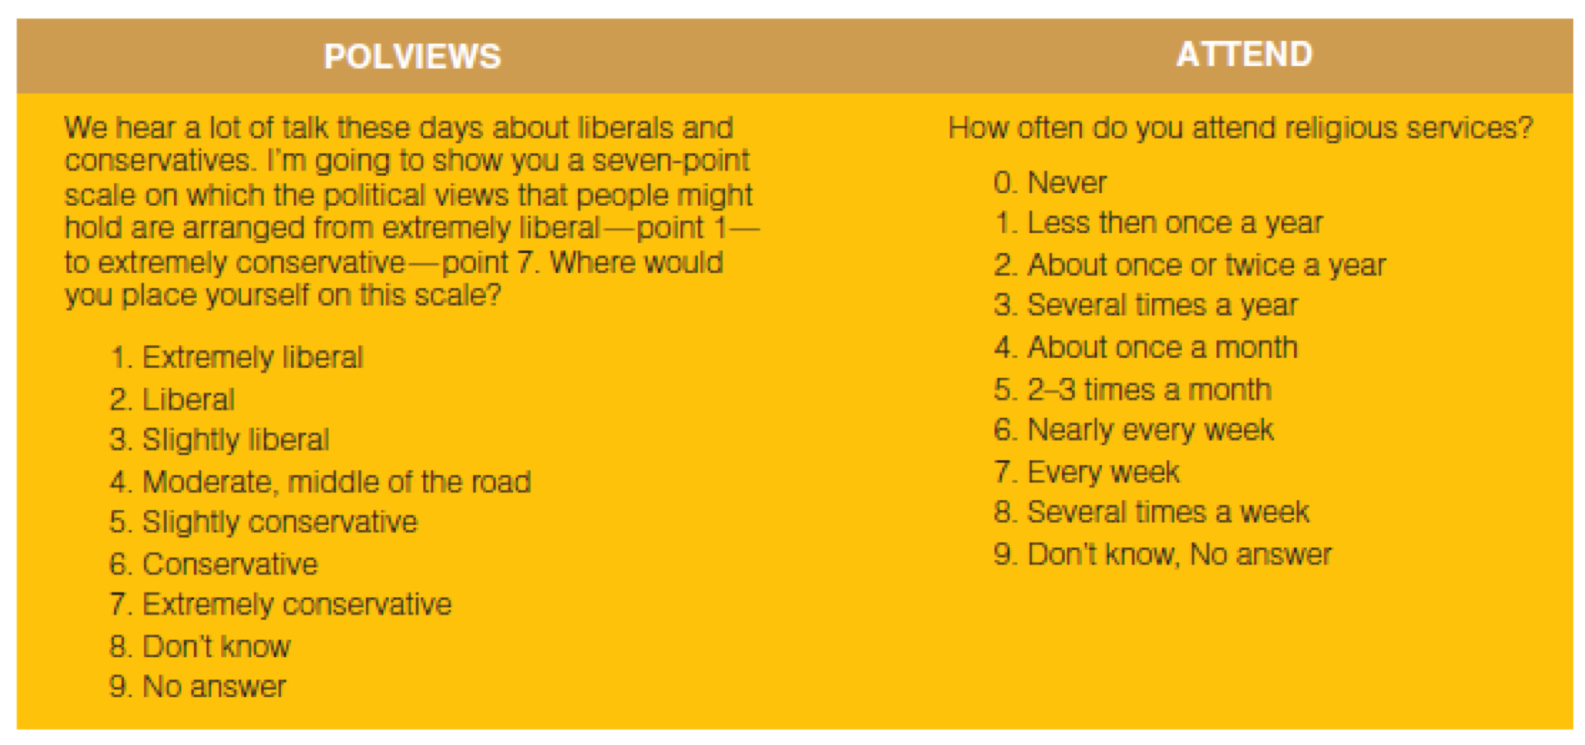
CODEBOOK EXAMPLE

Slide 7
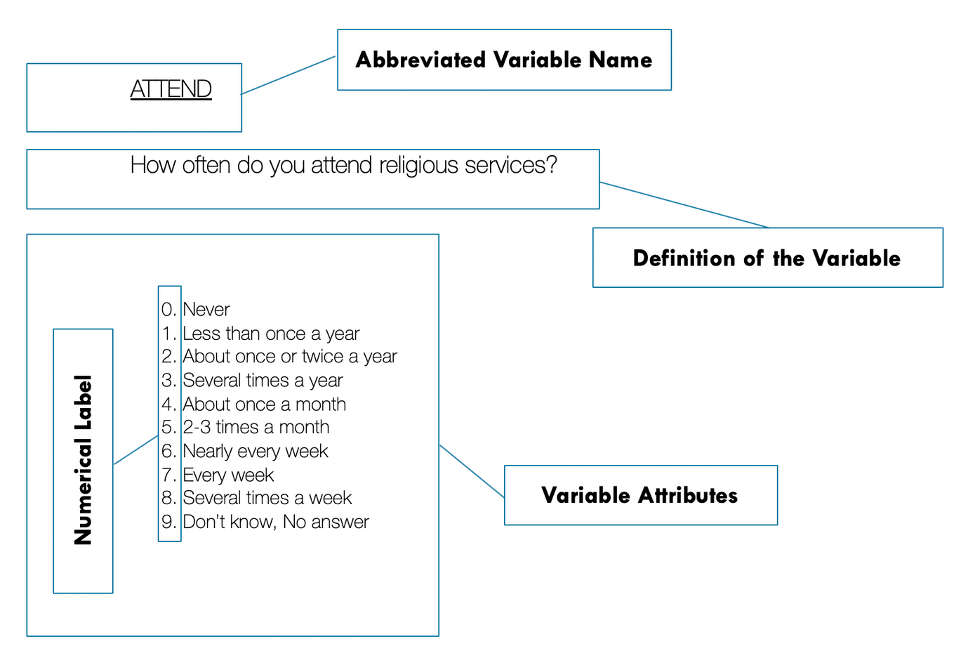
CODEBOOK EXAMPLE

Slide 8
LEVELS OF MEASUREMENT & QUANTITATIVE CODING
All levels of measurement can be assigned numerical values

Slide 9
NOMINAL
ORDINAL
INTERVAL-RATIO
Attributes have only the characteristics of exhaustiveness and mutually exclusiveness. Simple categories.
Attributes that classify, but cannot be ranked
religious affiliation, college major, hair color, birthplace, nationality
Attributes that classify and can be logically rank-ordered but lack an associated numerical value
socioeconomic status, level of conflict, prejudice, conservativeness
Distance between attributes has meaning.
Attributes classify, can be rank-ordered, and have an equal numerical distance between values
temperature (Fahrenheit), IQ score
Notes:
Variables whose attributes meet the requirements of a interval measure, and has a true zero point.
Examples: temperature (Kelvin), age, length of time, number of organizations, number of groups, number of A’s received in college

Slide 10
AGE
1 = 1
2 = 2
3 = 3
< 18 = 1
18-24 = 2
25-29 = 3
30+ = 4
POLITICAL AFFILIATION
INTERVAL-RATIO
Democrat = 1
Republican = 2
Independent = 3
Other = 4
NOMINAL
SEX
Female = 1
Male = 2
Other = 3
NOMINAL
SOCIOECONOMIC STATUS
Working = 1
Middle = 2
Upper-Middle = 3
The One Percent = 4
ORDINAL

Slide 11
EXHAUSTIVENESS & MUTUAL EXCLUSIVENESS
Exhaustive:
Ensuring that all possible units can fall into a category
(How do you handle missing responses and if people don't know how to answer)
Mutually Exclusive:
Units can only fall into one category

Slide 12
DATA ENTRY
DATA ANALYSIS
.CSV (e.g. Excel)
R
STATA
SPSS
SAS

Slide 13
TYPES OF QUANTITATIVE METHODS
Univariate Statistics
Bivariate Statistics
Multivariate Statistics

Slide 14
UNIVARIATE STATISTICS
DESCRIBING A SINGLE VARIABLE AT A TIME

Slide 15
UNIVARIATE STATISTICS
Central Tendency
Dispersion/Variability
Frequencies & Graphing

Slide 16
MEASURES OF CENTRAL TENDENCY
MODE
MEDIAN
MEAN
the most frequently observed value or attribute.
Can be used for all variable types: nominal, ordinal, and interval.
the value of the “middle” case in a rank-ordered set of observations.
Should only be used for two variable types: ordinal, and interval.
computed by summing the values of several observations and dividing by the number of observations. Average.
Should only be used for interval variables.

Slide 17
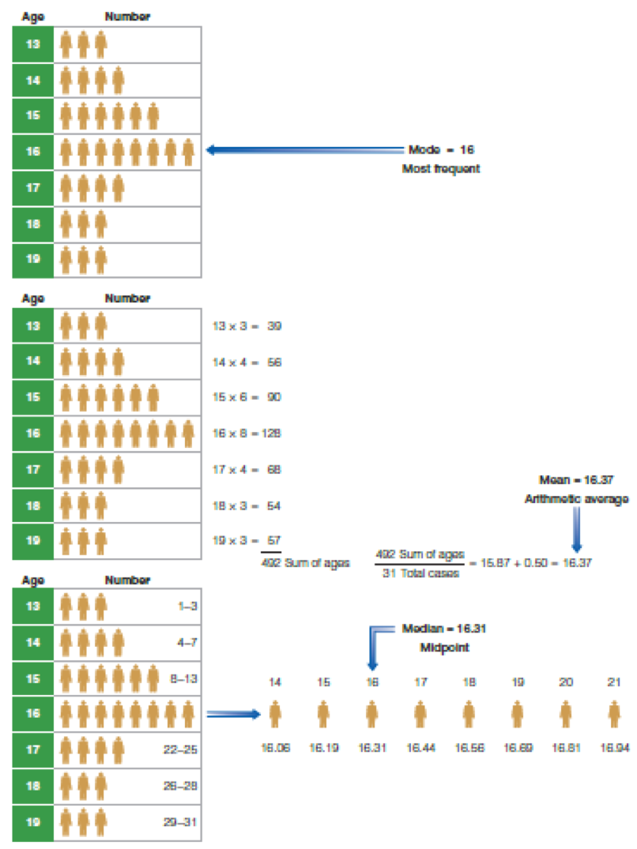
UNIVARIATE STATISTICS
EXAMPLE
Notes:
Some measures of central tendency (mean) are more susceptible to error because of extreme values.. Which is why for some interval variables, we use median instead of mean.
You could get the mean income of orange county, and it could be $1 million.. That might not be the lived reality. But it may be affected because Elon Musk moved in, and he’s a billionaire… so his high value is gonna pull the mean up… even if 96% of the population makes less than $500,000.

Slide 18
MEASURES OF VARIABILITY (DISPERSION)
STANDARD DEVIATION
RANGE
VARIANCE
distance between highest and lowest value
Should only be used for interval variables.
A measure of dispersion around the mean, but in squared units
Should only be used for interval variables.
A measure of dispersion around the mean, calculated so that approximately 68 percent of cases fall within one standard deviation of the mean, 95 percent within two, and 99.9 percent within three standard deviations.
Should only be used for interval variables.

Slide 19
WHY STANDARD DEVIATION?
SD gives us a measure of clustering around the mean (how close, or far, most cases are around the mean.

Slide 20
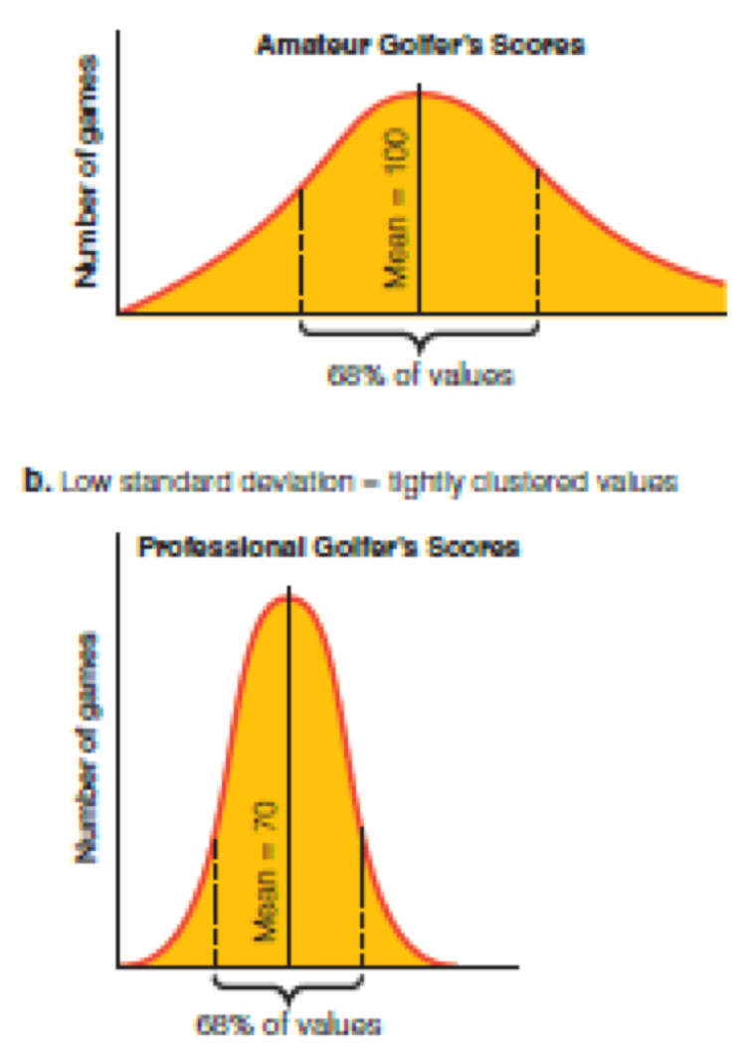
STANDARD DEVIATION EXAMPLE
Notes:
Higher standard deviation means that the data are more dispersed; lower means they’re more clustered.

Slide 21
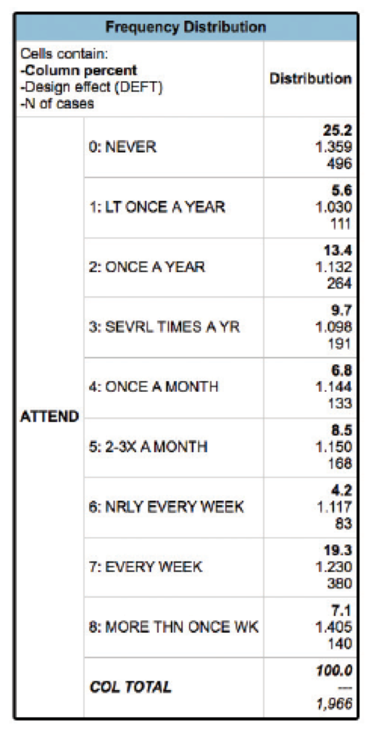
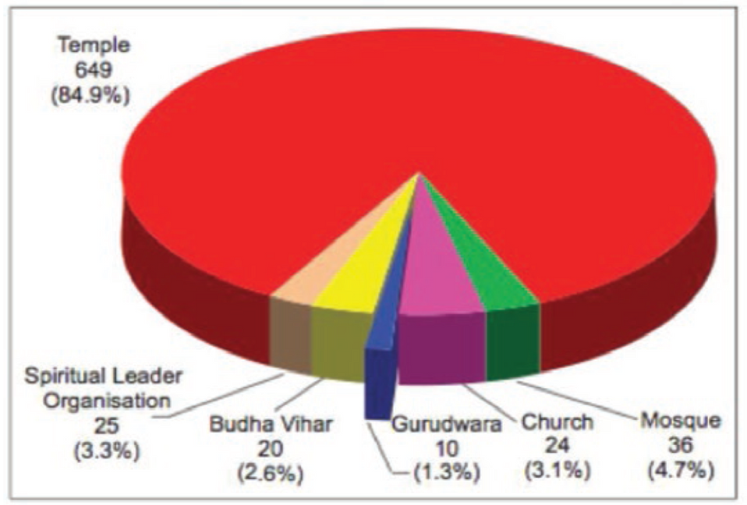
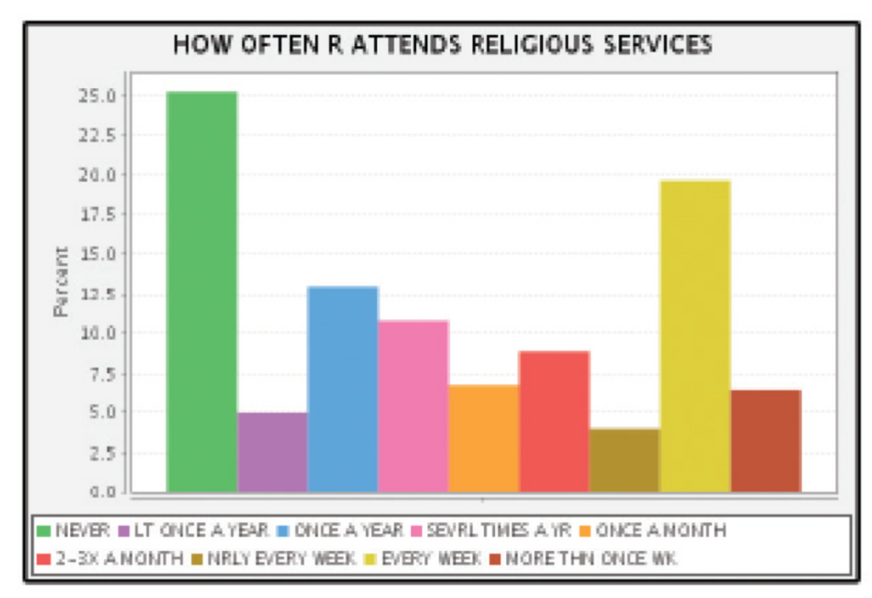
FREQUENCIES & GRAPHING
FREQUENCY DISTRIBUTION
PIE CHART
BAR GRAPH

Slide 22
BIVARIATE STATISTICS
EXAMINING RELATIONSHIPS BETWEEN TWO VARIABLES

Slide 23
BIVARIATE STATISTICS
The analysis of two variables simultaneously, for the purpose of determining an empirical relationship between them.
Chi Square
t-Test
Analysis of Variance (ANOVA)
Correlation

Slide 24
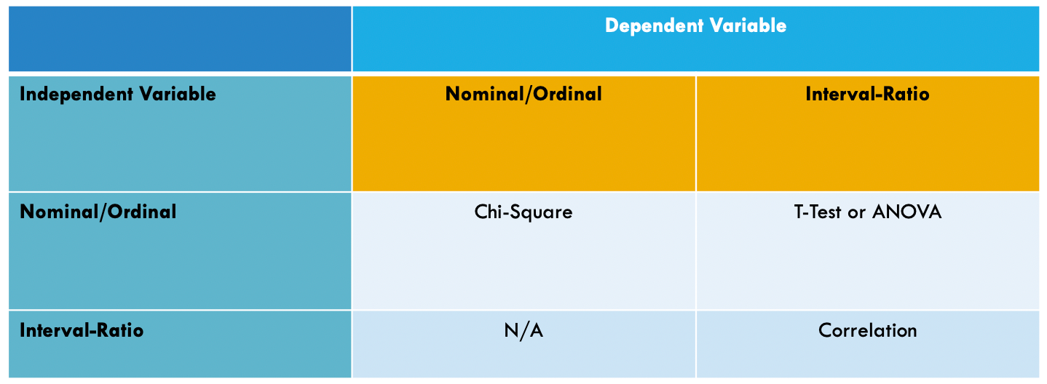
BIVARIATE STATISTICS

Slide 25
MULTIVARIATE STATISTICS
EXAMINING RELATIONSHIPS BETWEEN THREE OR MORE VARIABLES

Slide 26
MULTIVARIATE STATISTICS
The analysis of the simultaneous relationships among several variables.
MANOVA
Regressions (Multiple/Linear/OLS, Binomial Logistic, Multinomial Logistic, Poisson, Negative Binomial, Event History/Survival Analysis, Time-Series)
Notes:
Have multiple independent variables to see their relationship with the one dependent variable. Gets you closer to causality because, while bivariate relationships can tell you if two variables are associated/correlated, multivariate analysis can address spuriousness in the relationship between variables.

